Slide 1
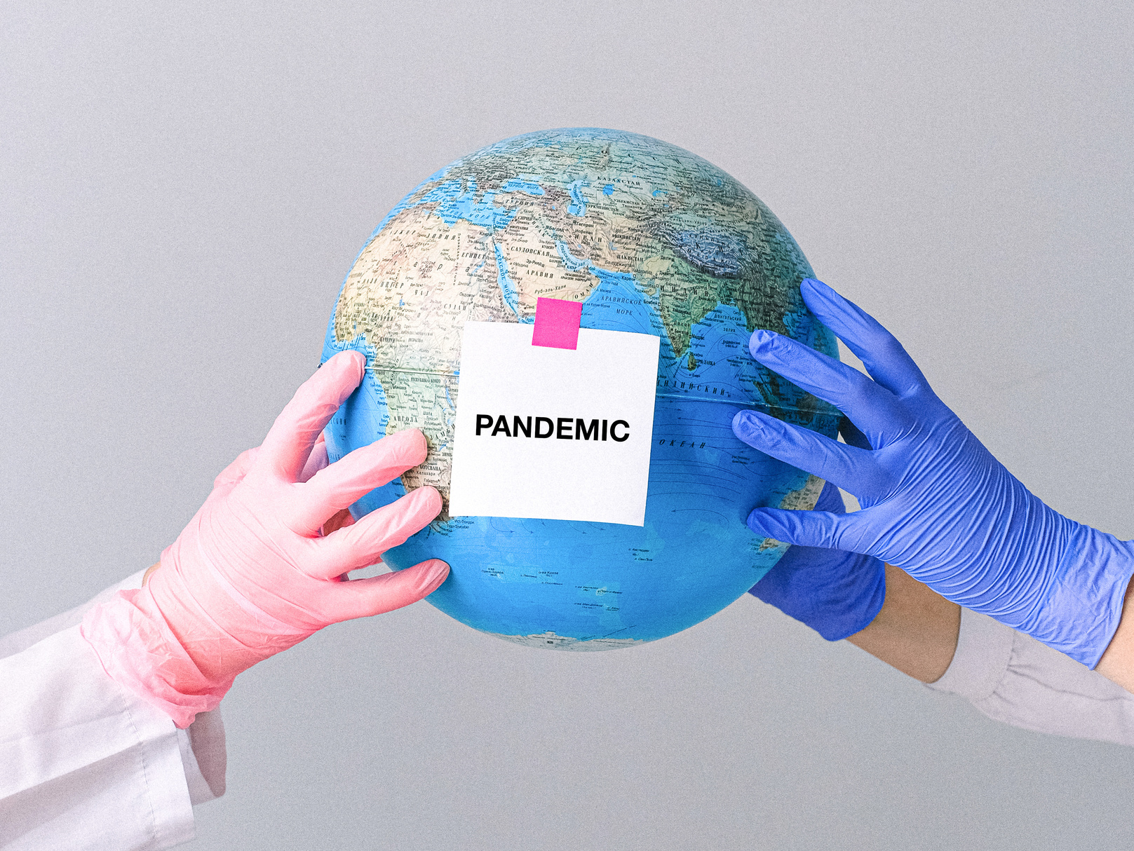

SADIA ACADEMY
COVID 19
Haya Kaadan Al-Shahrani

Slide 2
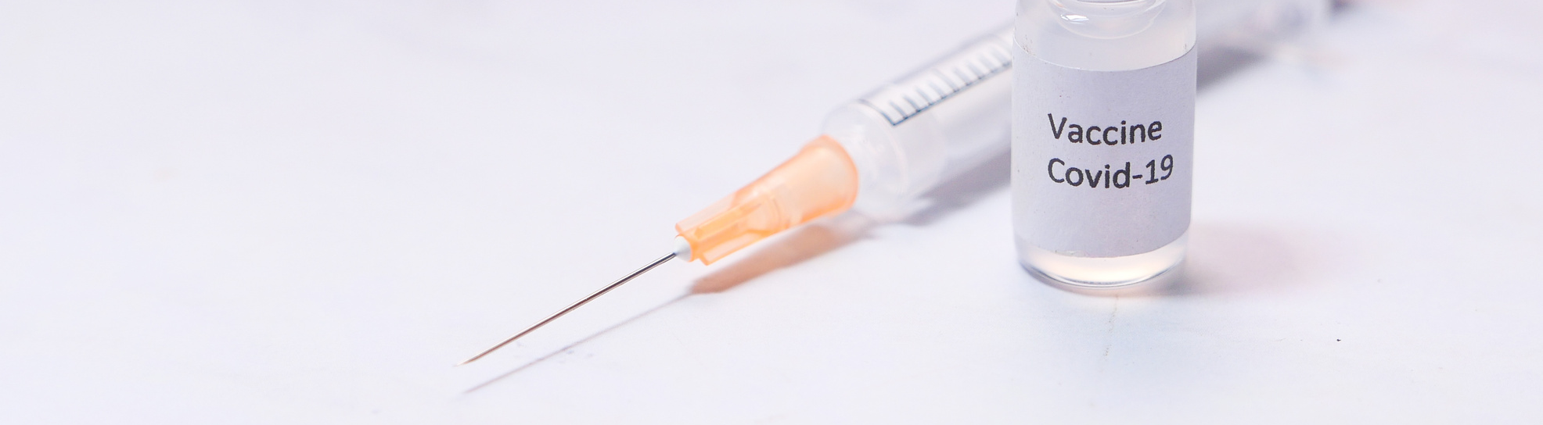
INTRODUCTION:
The outbreak of the Corona epidemic or Covid-19 was not the only dangerous virus that spread around the world, as it was also accompanied by a massive and rapid spread of rumors, false information and false news about it, and this fake news is considered part of a larger epidemic that causes confusion and fear and therefore we will explain in this project Confirmed cases of corona.

Slide 3


DISCUSSION TOPICS
1
Top Country/Region (Deaths)
2
Top Country/Region (Confirmed)
3
Confirmed cases in Saudi Arabia
4
Death cases in Saudi Arabia

Slide 4
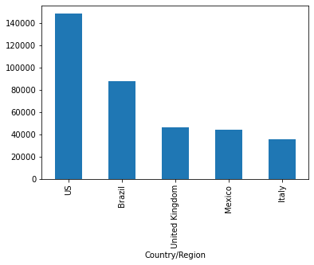
TOP COUNTRY/REGION (DEATHS)

Slide 5
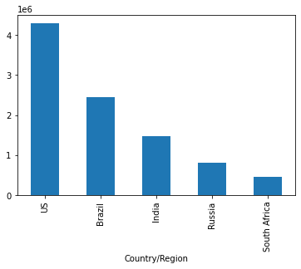
TOP COUNTRY/REGION (CONFIRMED)

Slide 6
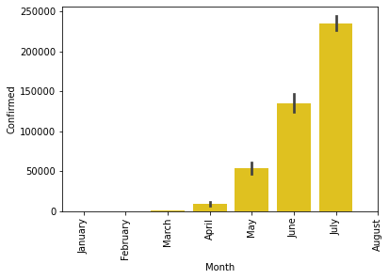
CONFIRMED CASES IN SAUDI ARABIA

Slide 7
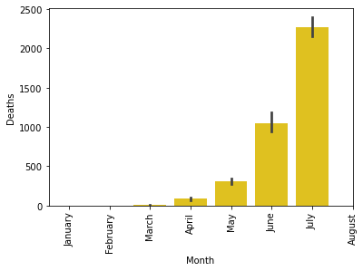
DEATH CASES IN SAUDI ARABIA

Slide 8







TOOLS

Slide 9

Thank you
for your time!

